Slide 1
SQL Server on the Microsoft Azure Platform SQL Server Ground to Cloud Workshop
Anna Hoffman (Thomas)
Azure SQL Engineering, Microsoft

Slide 2
Agenda
Azure SQL
Migrating to Azure SQL
Scenario – Tailspin Toys Gaming
Lab
Notes:
I will show you a lot, but I will give you access to full courses at the end so you can do on your own!

Slide 3
Azure SQL

Slide 4
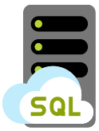
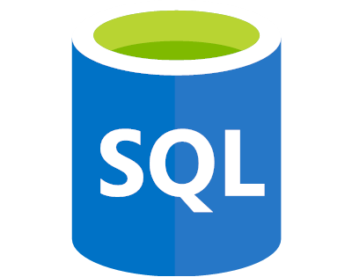
Azure SQL
SQL virtual machines
Managed instances
Databases
Best for migrations and applications requiring OS-level access
Best for most lift-and-shift migrations to the cloud
Best for modern cloud applications. Hyperscale and serverless options are available
SQL virtual machine
Single instance
Single database
Elastic pool
SQL Server and OS server access
Expansive SQL and OS version support
Automated manageability features for SQL Server
SQL Server surface area (vast majority)
Native virtual network support
Fully managed service
Hyperscale storage (up to 100TB)
Serverless compute
Fully managed service
Resource sharing between multiple databases to price optimize
Simplified performance management for multiple databases
Fully managed service

Slide 5
Azure SQL Database — Everything built-in
Business continuity
High availability
Automated backups
Long term backup retention
Geo-replication
Scale
Advanced security
Automatic tuning
Built-in monitoring
Built-in intelligence
Notes:
Business continuity enables your business to continue operating in the face of disruption, particularly to its computing infrastructure.
High availability of Azure SQL Database guarantees your databases are up and running 99.99% of the time, no need to worry about maintenance/downtimes.
2 read replicas - GP
3 replicas, 1 read-scale replica, zone-redundant HA - BC
Primary read/write replica + up to 4 read replicas - HS
Automated backups are created and use Azure read-access geo-redundant storage (RA-GRS) to provide geo-redundancy.
Also Point in Time restore
Long term backup retention enables you to store specific full databases for up to 10 years.
Geo-replication by creating readable replicas of your database in the same or different data center (region). You can manually failover to readable replicas
Also Auto-failover groups allows an application to recover in case of a data center outage
Scale by easily adding more resources (CPU, memory, storage) without long provisioning.
Advanced security detects threats and vulnerabilities in your databases and enables you to secure your data.
Automatic tuning analyzes your workload and provides you the recommendations that can optimize performance of your applications by adding indexes, removing unused indexes, and automatically fixing the query plan issues.
Built-in monitoring capabilities enable you to get the insights into performance of your databases and workload, and troubleshoot the performance issues.
Built-in intelligence automatically identifies the potential issues in your workload and provides you the recommendations that can help you to fix the problems.

Slide 6

Azure SQL Database — Everything built in
VMs
configurable
Business continuity
High availability
Automated backups
Long term backup retention
Geo-replication
Scale
Advanced security
Automatic tuning
Built-in monitoring
Built-in intelligence
Notes:
Configurable could be replaced with “choice of automation”
SQL VM with defaults; “automated security patching” comes as built-in.
But, can use services (automations provided by Microsoft for free) to enable:
-HA for an SLA they choose, either 99.95% or 99.99%
-Automated backup
-Advanced threat detection and vulnerability assessment
They can do the followings manually, but we do not have an automation for that:
-Add readable DR replica in same region; different zone
-Add a Geo-Dr replica
With VM deployment type they can “Control” the level of Managebility they prefer.
E.g., do not have to sacrifice their patching or update policies to get automated HADR.
Can choose form available administration services and configure only the ones they prefer.
Flexible platform where you can add-on the services they want and keep manual maintenance on others.

Slide 7



The Allscripts prescription for agility: lift and shift to the cloud
Allscripts is a leading healthcare software manufacturer, serving physician practices, hospitals, health plans, and Big Pharma. To transform its applications frequently and host them securely and reliably, Allscripts has started to use Microsoft Azure. In just three weeks, the company lifted and shifted dozens of acquired applications running on 1,000 virtual machines to Azure with Azure Site Recovery. Allscripts also develops software in Azure and realizes dramatic time-to-market gains and savings by using the Azure platform as a service offering.
Microsoft Azure
Azure Site Recovery
Azure SQL Database
Azure Virtual Machines
Azure Cosmos DB
10,000 employees
Partner professional services
United States
Notes:
https://customers.microsoft.com/en-us/story/allscripts-partner-professional-services-azure

Slide 8
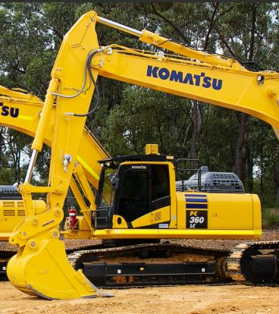
Komatsu achieves breakthrough performance gains and savings with Azure SQL Database Managed Instance
Challenge
Had multiple mainframe applications for different types of data, and needed to consolidate them into a single system so that different parts of the organization can easily get a holistic view of data from different sources
Impact
Moved the entire database and the Discovery Hub analytics implementation to Azure SQL Database Managed Instance in less than two weeks, and since then we’ve seen a 49 percent cost reduction and 25 to 30 percent performance gains.
“We determined Azure SQL Database Managed Instance was the best choice for us in terms of scalability, cost, and performance.… We’ve seen a 49 percent cost reduction and 25 to 30 percent performance gains..”
Nipun Sharma: Analytics Architect, Business Technology and Systems
Komatsu Australia
Notes:
https://customers.microsoft.com/en-us/story/komatsu-australia-manufacturing-azure

Slide 9


AccuWeather weathers the storm with Azure
The company first moved its API business to Azure. AccuWeather sells a host of weather-related APIs that news outlets and other companies plug into their enterprise resource planning, customer relationship management, and other business applications. The company receives more than 40 billion API calls a day for weather information, and Azure provides a more scalable, cost-effective way to manage this service.
Next the company moved its big data storage and processing, using services such as Azure Blob storage, Azure Data Factory, and Azure SQL Database.
When AccuWeather set out to build an automated, scalable weather prediction service for business customers, it turned to Azure as well. To create highly accurate forecasts, Radich’s team needed sophisticated machine learning tools that it could customize using R and Python code.
“With Azure, we have access to sophisticated data science services in a real-time, on-demand basis, which helps us innovate faster.”
- Chris Patti: Chief Technology Officer, AccuWeather
Azure API Management
Azure App Service
Azure Data Factory
Azure Machine Learning
Azure SQL Database
Azure Storage
Medium (50 - 999 employees)
Professional Services
USA
Notes:
https://customers.microsoft.com/en-us/story/accuweather-partner-professional-services-azure

Slide 10


World-class, cloud-enabled time and labor application.
Challenge
Flex Time by Paychex handles 13 million timecards and 3 million distinct punches on any given day for over 650,000 customers. With an increasing volume of customers, however, managing that environment became very cumbersome. Guaranteeing uptime meant constant investments in new hardware, which was both time-consuming and capital-intensive.
Impact
Paychex engineers are freed from managing infrastructure, licensing, and database spin up and spin down. Built-in intelligent features like automatic tuning optimize database performance, leaving them to focus on what they do best: understand how clients are accessing the app and provide value in their continuous delivery pipeline.
“Azure SQL Database allows us to execute upgrades and releases without our customers ever knowing it, which is critical for an application that runs 24/7/365.”
Dave Wilson: Sr. Director of IT Infrastructure and Architecture
Notes:
https://customers.microsoft.com/en-us/story/paychex-azure-sql-database-us

Slide 11
General Purpose
Feature | Description
Number of vCores* | 8, 16, 24 (Gen 4) 8, 16, 24, 32, 40, 64, 80 (Gen 5)
SQL Server version / build | SQL Server (latest available)
Min storage size | 32 GB
Max storage size | 8 TB
Max storage per database | Determined by the max storage size per instance
Expected storage IOPS | 500-7500 IOPS per data file (depends on data file). See Premium Storage
Number of data files (ROWS) per the database | Multiple
Number of log files (LOG) per database | 1
Managed automated backups | Yes
HA | Based on remote storage and Azure Service Fabric
Built-in instance and database monitoring and metrics | Yes
Automatic software patching | Yes
VNet - Azure Resource Manager deployment | Yes
VNet - Classic deployment model | No
Portal support | Yes
Redundant nodes
Azure storage accounts
Active compute nodes

Slide 12
Business Critical
Primary endpoint
(read-write)
Read-only endpoint
Feature | Description
Number of vCores* | 8, 16, 24, 32 (Gen 4) 8, 16, 24, 32, 40, 64, 80 (Gen 5)
SQL Server version / build | SQL Server (latest available)
Additional features | In-Memory OLTP 1 additional read-only replica (Read Scale-Out)
Min storage size | 32 GB
Max storage size | Gen 4: 1 TB (all vCore sizes Gen 5:1 TB for 8, 16 vCores 2 TB for 24 vCores 4 TB for 32, 40, 64, 80 vCores
Max storage per database | Determined by the max storage size per instance
Number of data files (ROWS) per the database | Multiple
Number of log files (LOG) per database | 1
Managed automated backups | Yes
HA | Based on Always On Availability Groups and Azure Service Fabric
Built-in instance and database monitoring and metrics | Yes
Automatic software patching | Yes
VNet - Azure Resource Manager deployment | Yes
VNet - Classic deployment model | No
Portal support | Yes
Always On AG
SQL
Super-fast SSD
SQL
Primary replica
Secondary replica
SQL
SQL
Secondary replica
Secondary replica
Business Critical service tier: collocated compute and storage

Slide 13
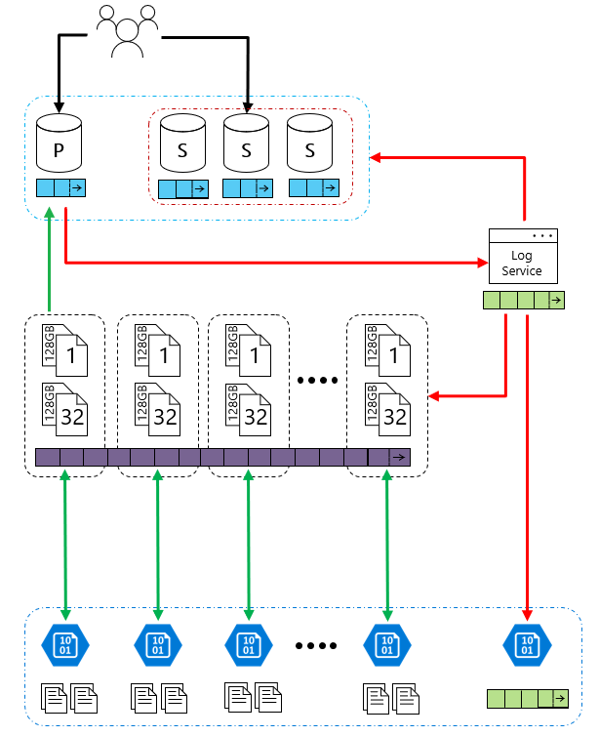
Hyperscale
Feature | Description
Number of vCores* | Gen4: 1 to 24 vCore Gen5: 2 to 80 vCore
SQL Server version / build | SQL Server (latest available)
Additional features | 4 read-scale replicas 100TB Data Support Constant Time Operations
Min storage size | 4 GB
Max storage size | 100TB Grows as customer data grows
Max storage per database | Determined by the max storage size per instance
Number of data files (ROWS) per the database | Multiple
Number of log files (LOG) per database | 1
Managed automated backups | Yes
HA | High Availability is ensured on the storage layer
Built-in instance and database monitoring and metrics | Yes
Automatic software patching | Yes
VNet - Azure Resource Manager deployment | Yes
VNet - Classic deployment model | No
Portal support | Yes
Hyperscale Service Tier – Availability of Storage

Slide 14
Flexible compute, storage & performance options
Simplicity
We remain committed to the DTU-based model and the simplicity it offers customers who want a pre-configured solution
Flexibility:
The vCore-based model reflects our commitment to customer choice and to simplify the hybrid benefit for customers migrating from on-premises
Customers pay for:
Service tier + number of vCores
Type and amount of data storage
Number of IO
Backup storage (RA-GRS)
Service tier | General purpose |  | Business critical |  | Hyperscale
Best for | Most budget-oriented workloads |  | Critical business applications with high IO requirements. |  | VLDB OLTP and HTAP workloads with highly scalable storage and read-scale requirements
Deployment option | Single / Elastic Pools | Managed Instance | Single / Elastic Pools | Managed Instance | Single
Compute tiers | Gen4: 1 to 24 vCore Gen5: 2 to 80 vCore | Gen4: 4 to 24 vCore Gen5: 4 to 80 vCore | Gen4: 1 to 24 vCore Gen5: 2 to 80 vCore | Gen4: 4 to 24 vCore Gen5: 4 to 80 vCore | Gen4: 1 to 24 vCore Gen5: 2 to 80 vCore
Storage | Premium remote |  | Local SSD |  | Local SSD Cache
 | 32GB – 8TB per instance | 32GB – 8TB per instance | 32GB – 4TB per instance | 32GB – 8TB per instance | Scale from 5GB to 100TB of storage in 1GB increments
In-Memory | Not supported |  | Supported |  | Not supported
Read-write IO | ~2ms for all data access |  | <0.5ms for all data access |  | <0.5ms for hot data access ~2ms otherwise
Availability | 2 read replicas |  | 3 read replicas, zone-redundant HA | 3 replicas, 1 read-scale replica, zone-redundant HA | Primary read/write replica + up to 4 read replicas
Backups | RA-GRS, 7-35 days (7 days by default) |  | RA-GRS, 7-35 days (7 days by default) |  | LRS, ZRS, RA-GRS, 7-35 days (7 days by default)
For latest information reference: https://azure.microsoft.com/en-us/pricing/details/sql-database/
Notes:
https://azure.microsoft.com/en-us/pricing/details/sql-database/
vCore model so we can get AHB: 1 Enterprise license core = 1 Business Critical core
Business critical because online gaming wants the highest performance and HA
Gen 5 so we can scale our compute more
Also for read-scale replica, zone redundant HA
Zone-redundant storage (ZRS) replicates your data synchronously across three storage clusters in a single region. Each storage cluster is physically separated from the others and is located in its own availability zone (AZ). Each availability zone—and the ZRS cluster within it—is autonomous and includes separate utilities and networking features. A write request to a ZRS storage account returns successfully only after the data is written to all replicas across the three clusters.
When you store your data in a storage account using ZRS replication, you can continue to access and manage your data if an availability zone becomes unavailable. ZRS provides excellent performance and low latency. ZRS offers the same scalability targets as locally redundant storage (LRS).

Slide 15
Migrating to Azure SQL

Slide 16
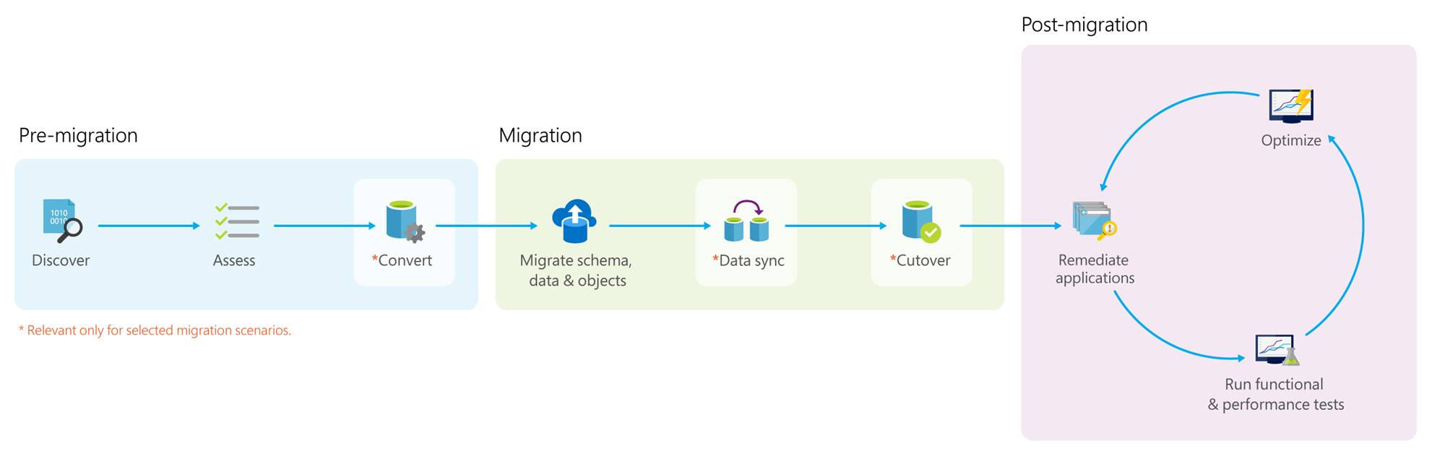
Data Migration Process
Notes:
*Pre-migration*:
- **Discover**: Inventory your source database assets and perform an application stack discovery.
- **Assess**: Assess source workloads and fix recommendations.
- **Convert**: Convert the source schema to work in the target environment. This is only relevant for heterogeneous migrations.
*Migration*:
- **Migrate schema, data, and objects**: Migrate the source schema and then migrate the source data to the target.
- **Sync data**: Sync your target schema and data with the source. This is only relevant for minimal-downtime migrations.
- **Cutover**: Cut over from the source to the target environment. This is only relevant for minimal-downtime migrations.
*Post-migration*:
- **Remediate applications**: Iteratively make any necessary changes to your applications.
- **Perform Tests**: Iteratively run functional and performance tests.
- **Optimize**: Based on the tests you performed, address any performance issues and then retest to confirm the performance improvements.

Slide 17
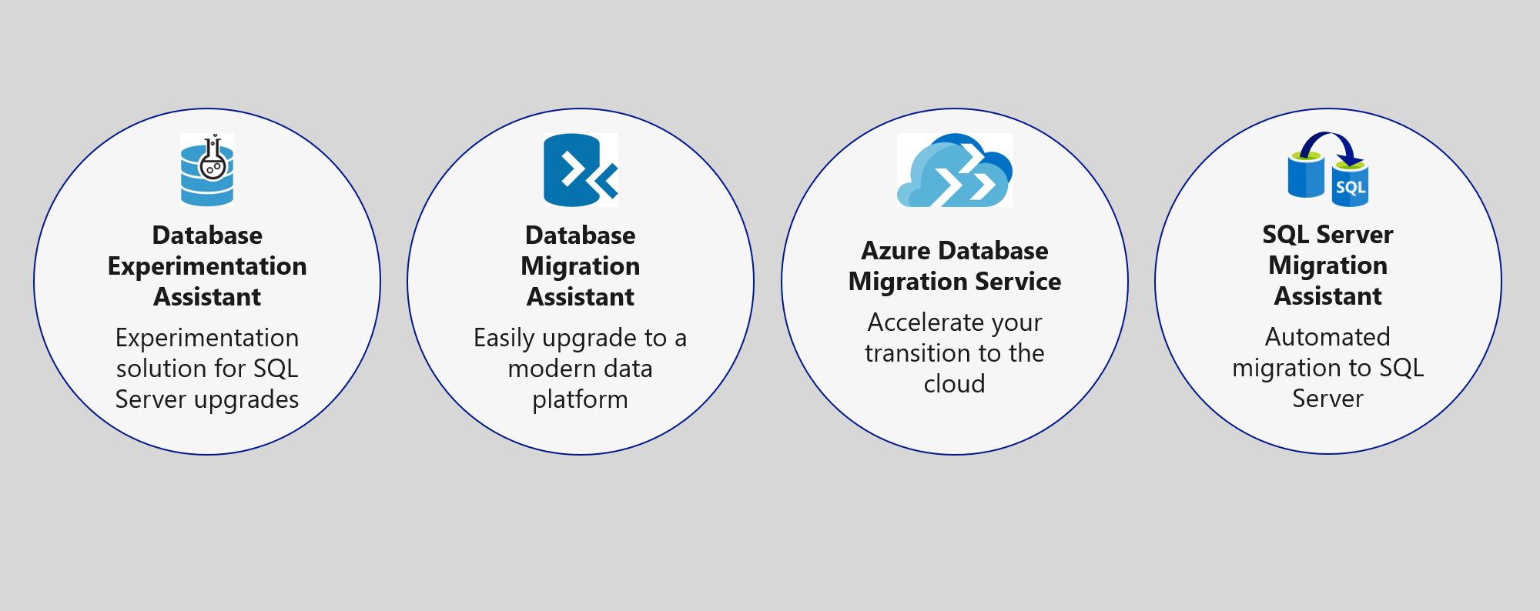
Upgrade & migration tools
NEW
Azure Migrate + DMS + DMA
Notes:
The Azure SQL data platform consists of three options:
SQL Server on an Azure VM
Azure SQL Database Managed Instance
Azure SQL Database
Each of the options will be discussed in more detail in the slides that follow.

Slide 18
Azure Migration Program (AMP)
Available to all Azure customers, scaled through specialized migration partners
Best practice guidance
Offers and incentives
Technical skill building
Infrastructure and data foundations
Migration planning and execution
Digital resources
Migration
Tools
Azure trainers
FastTrack for Azure engineers
Specialized partners
Reduce cost and risk | Accelerate migration velocity | Deliver customer success
Learn more | Azure.com/AMP
Notes:
The Azure Migration Program gives you prescriptive guidance for a step by step approach to cloud migration. AMP offers the opportunity to work closely with Microsoft experts and specialized migration partners to simplify and accelerate your migration.
The program delivers:
Technical skill building to ensure your organization can successfully adopt Azure
Best practices for a step by step approach from start to finish
Azure engineering support for data and infrastructure foundations
Expert guidance from specialized migration partners
Free Azure tools to help you efficiently execute migrations
And cost effective offers to help you save money before, during, and after migration

Slide 19
Scenario

Slide 20
Modernizing the WideWorldImporters Gaming Division
Tailspin Toys Gaming (online gameplay) was acquired by WideWorldImporters
Primarily SQL Server 2008 R2
Founded in 2010, exponential growth since then
Gaming services (VMs/databases) run on rented hardware
Primarily software developers, few infrastructure and database resources
Desire to build more intelligent applications with AI and Machine Learning
What, when, and how can I migrate to the cloud?
Want to leverage new security and performance features in Azure they’ve heard about
Need Service Broker, do not want to rearchitect the solution to use an alternative
Applications need better availability and less downtime

Slide 21
Tailspin Toys Gaming (online gameplay)
Primarily SQL Server 2008 R2
Founded in 2010, exponential growth since then
Gaming services (VMs/databases) run on rented hardware
Primarily software developers, few infrastructure and database resources
Desire to build more intelligent applications with AI and Machine Learning
What, when, and how can I migrate to the cloud?
Want to leverage new security and performance features in Azure they’ve heard about
Need Service Broker, do not want to rearchitect the solution to use an alternative
Applications need better availability and less downtime

Slide 22
Pre-migration

Slide 23
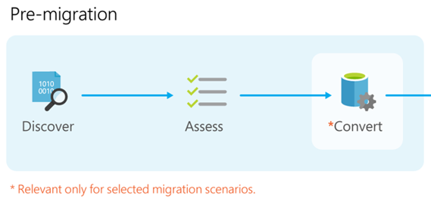
Data Migration Process
Notes:
*Pre-migration*:
- **Discover**: Inventory your source database assets and perform an application stack discovery.
- **Assess**: Assess source workloads and fix recommendations.
- **Convert**: Convert the source schema to work in the target environment. This is only relevant for heterogeneous migrations.
*Migration*:
- **Migrate schema, data, and objects**: Migrate the source schema and then migrate the source data to the target.
- **Sync data**: Sync your target schema and data with the source. This is only relevant for minimal-downtime migrations.
- **Cutover**: Cut over from the source to the target environment. This is only relevant for minimal-downtime migrations.
*Post-migration*:
- **Remediate applications**: Iteratively make any necessary changes to your applications.
- **Perform Tests**: Iteratively run functional and performance tests.
- **Optimize**: Based on the tests you performed, address any performance issues and then retest to confirm the performance improvements.

Slide 24
Demo: Database Discovery and Assessment (Module 4.4)

Slide 25
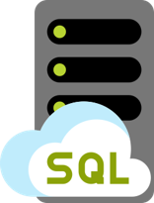
Tailspin Toys – Recommended database
Azure SQL Database Managed Instance
Platform-as-a-Service (PaaS)
Supports database migration from on-premises with minimal to no database changes (i.e. Service Broker)
Provides the benefits of Azure SQL Database but adds capabilities that were previously only available in SQL VMs
Includes a native virtual network (VNet) and near 100% compatibility with on-premises SQL Server
Notes:
Managed instance is a new deployment option of Azure SQL Database, providing near 100% compatibility with the latest SQL Server on-premises (Enterprise Edition) Database Engine.
Provides a native virtual network (VNet) implementation that addresses common security concerns, and a business model favorable for on-premises SQL Server customers.
The managed instance deployment model allows existing SQL Server customers to lift and shift their on-premises applications to the cloud with minimal application and database changes.
At the same time, the managed instance deployment option preserves all PaaS capabilities (automatic patching and version updates, automated backups, high-availability ), that drastically reduces management overhead and TCO.
Adds features that are not available in Azure SQL Database, such as cross-database queries, linked servers, CLR modules, and Service Broker.

Slide 26
Flexible compute, storage & performance options
Simplicity
We remain committed to the DTU-based model and the simplicity it offers customers who want a pre-configured solution
Flexibility:
The vCore-based model reflects our commitment to customer choice and to simplify the hybrid benefit for customers migrating from on-premises
Customers pay for:
Service tier + number of vCores
Type and amount of data storage
Number of IO
Backup storage (RA-GRS)
Service tier | General purpose |  | Business critical |  | Hyperscale
Best for | Most budget-oriented workloads |  | Critical business applications with high IO requirements. |  | VLDB OLTP and HTAP workloads with highly scalable storage and read-scale requirements
Deployment option | Single / Elastic Pools | Managed Instance | Single / Elastic Pools | Managed Instance | Single
Compute tiers | Gen4: 1 to 24 vCore Gen5: 2 to 80 vCore | Gen4: 4 to 24 vCore Gen5: 4 to 80 vCore | Gen4: 1 to 24 vCore Gen5: 2 to 80 vCore | Gen4: 4 to 24 vCore Gen5: 4 to 80 vCore | Gen4: 1 to 24 vCore Gen5: 2 to 80 vCore
Storage | Premium remote |  | Local SSD |  | Local SSD Cache
 | 32GB – 8TB per instance | 32GB – 8TB per instance | 32GB – 4TB per instance | 32GB – 8TB per instance | Scale from 5GB to 100TB of storage in 1GB increments
In-Memory | Not supported |  | Supported |  | Not supported
Read-write IO | ~2ms for all data access |  | <0.5ms for all data access |  | <0.5ms for hot data access ~2ms otherwise
Availability | 2 read replicas |  | 3 read replicas, zone-redundant HA | 3 replicas, 1 read-scale replica, zone-redundant HA | Primary read/write replica + up to 4 read replicas
Backups | RA-GRS, 7-35 days (7 days by default) |  | RA-GRS, 7-35 days (7 days by default) |  | LRS, ZRS, RA-GRS, 7-35 days (7 days by default)
For latest information reference: https://azure.microsoft.com/en-us/pricing/details/sql-database/
Notes:
https://azure.microsoft.com/en-us/pricing/details/sql-database/
vCore model so we can get AHB: 1 Enterprise license core = 1 Business Critical core
Business critical because online gaming wants the highest performance and HA
Gen 5 so we can scale our compute more
Also for read-scale replica, zone redundant HA
Zone-redundant storage (ZRS) replicates your data synchronously across three storage clusters in a single region. Each storage cluster is physically separated from the others and is located in its own availability zone (AZ). Each availability zone—and the ZRS cluster within it—is autonomous and includes separate utilities and networking features. A write request to a ZRS storage account returns successfully only after the data is written to all replicas across the three clusters.
When you store your data in a storage account using ZRS replication, you can continue to access and manage your data if an availability zone becomes unavailable. ZRS provides excellent performance and low latency. ZRS offers the same scalability targets as locally redundant storage (LRS).

Slide 27
Migration

Slide 28
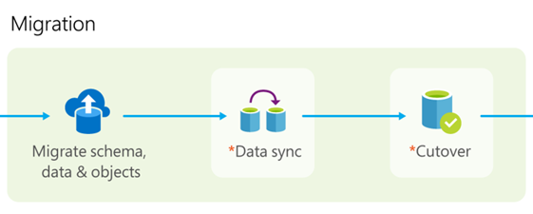
Data Migration Process
Notes:
*Pre-migration*:
- **Discover**: Inventory your source database assets and perform an application stack discovery.
- **Assess**: Assess source workloads and fix recommendations.
- **Convert**: Convert the source schema to work in the target environment. This is only relevant for heterogeneous migrations.
*Migration*:
- **Migrate schema, data, and objects**: Migrate the source schema and then migrate the source data to the target.
- **Sync data**: Sync your target schema and data with the source. This is only relevant for minimal-downtime migrations.
- **Cutover**: Cut over from the source to the target environment. This is only relevant for minimal-downtime migrations.
*Post-migration*:
- **Remediate applications**: Iteratively make any necessary changes to your applications.
- **Perform Tests**: Iteratively run functional and performance tests.
- **Optimize**: Based on the tests you performed, address any performance issues and then retest to confirm the performance improvements.

Slide 29
Demo: Migrate to Azure SQL Database Managed Instance (Module 5.1)

Slide 30
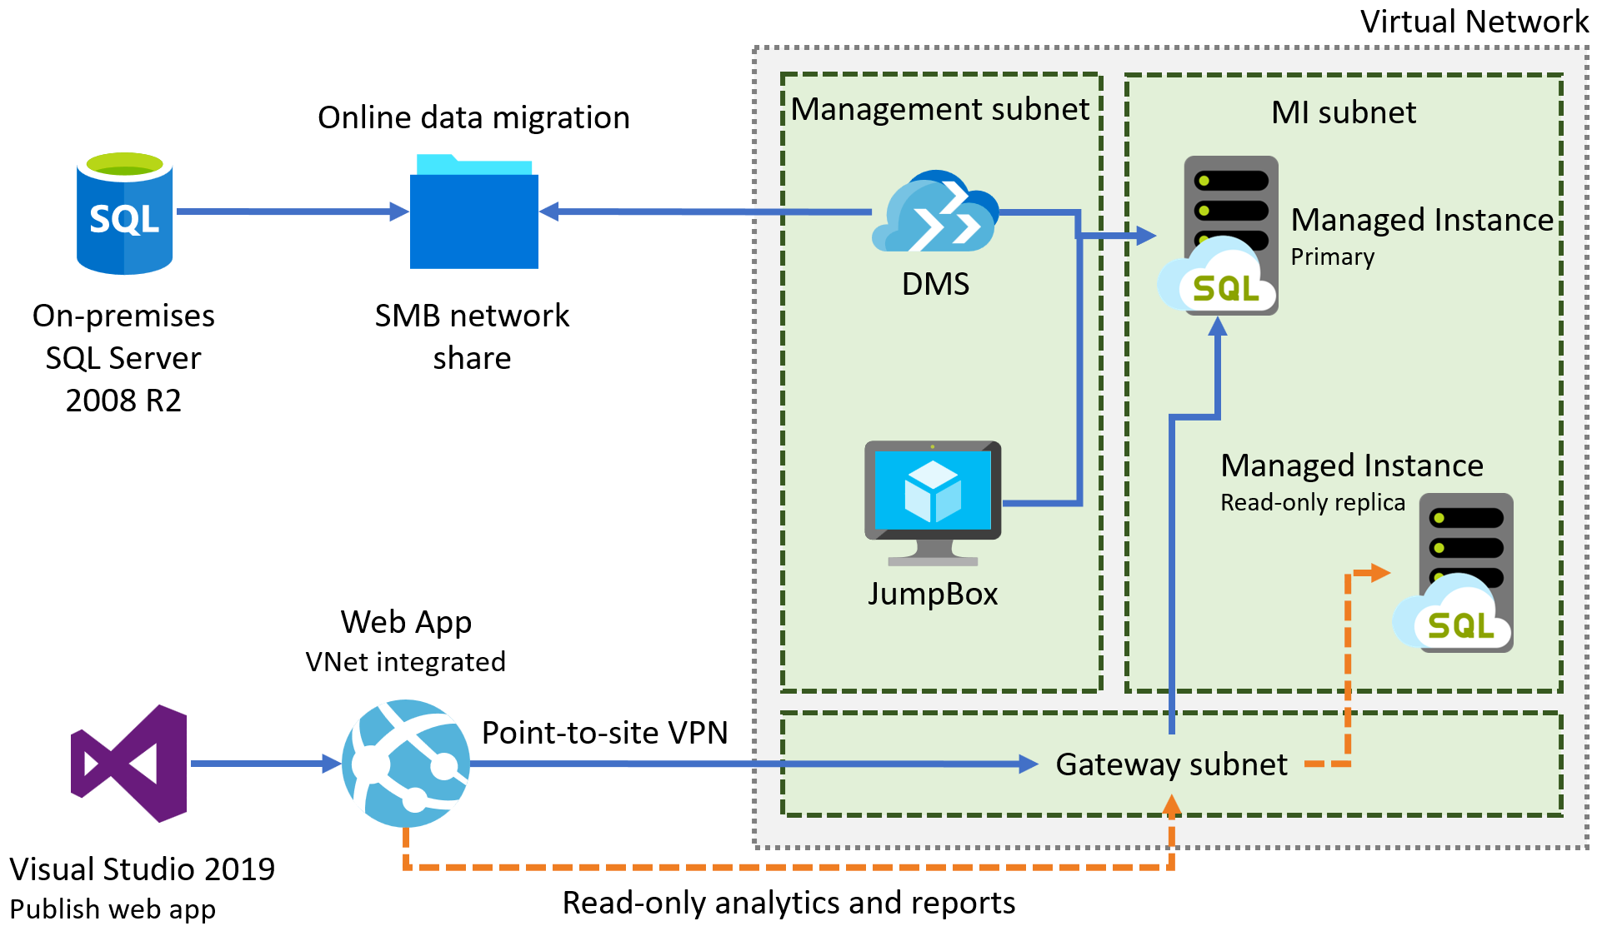
PoC – Gaming services
Notes:
Diagram of the preferred solution for the gaming services. The gaming services are hosted in a VNet, with subnets for MI, Game, Management, Auth, and a Gateway subnet. SQL MI instances are hosted in the MI subnet. Gaming IaaS VMs are hosted in the Game subnet. Authorization VMs are in the Auth subnet, and a JumpBox is in the Management subnet. On-premises resources can access the VNet through ExpressRoute or a VPN gateway.

Slide 31
PoC – Gaming services
Notes:
Diagram of the preferred solution for the gaming services. The gaming services are hosted in a VNet, with subnets for MI, Game, Management, Auth, and a Gateway subnet. SQL MI instances are hosted in the MI subnet. Gaming IaaS VMs are hosted in the Game subnet. Authorization VMs are in the Auth subnet, and a JumpBox is in the Management subnet. On-premises resources can access the VNet through ExpressRoute or a VPN gateway.

Slide 32


Preferred migration solution
Azure Migrate
Data Migration Assistant
Azure Database Migration Service
Azure Site Recovery
Partner or Azure Migrate Program engagement
Azure Hybrid Benefit
Prepay for Reserved Capacity
Notes:
Cost minimization
Azure Hybrid Benefit
Reserved capacity payments
DMS
3 month timeframe
DMS
ASR
AMP
Partner engagement
Dedicated resources

Slide 33
Azure Hybrid Benefit for SQL Server
License trade-in values
Take an inventory of on-premises licenses to determine potential for conversion
Convert on-premises cores to vCores to maximize value of investments
1 Standard license core = 1 General Purpose or Hyperscale core
1 Enterprise license core = 1 Business Critical core
1 Enterprise license core = 4 General Purpose or Hyperscale cores (virtualization benefit)
SQL Server cores with SA license
vCores on Azure SQL Database
SQL Server Standard Edition
General purpose or Hyperscale vCore
Business critical vCore
SQL Server Enterprise Edition
4x General purpose or Hyperscale vCores
Notes:
SQL Server Enterprise Edition customers can use an unlimited virtualization benefit for their on-premises workloads. However, moving to the cloud to take advantage of its management, flexibility and cost benefits can be cost prohibitive for some heavily virtualized customers. The Azure Hybrid Benefit for SQL Server provides SQL Enterprise Edition customers with Software Assurance the ability to get 4 cores in the cloud for every 1 core they own on-premises for workloads moving to the General Purpose or Hyperscale SKU – the SKU that best meets the requirements for highly virtualized workloads. This makes moving virtualized applications to SQL Database highly cost effective as customers will not have to purchase incremental vCores to move their virtualized application to the cloud.

Slide 34
Post-Migration

Slide 35
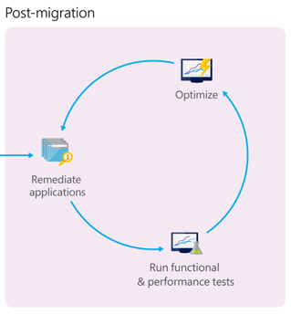
Data Migration Process
Notes:
*Pre-migration*:
- **Discover**: Inventory your source database assets and perform an application stack discovery.
- **Assess**: Assess source workloads and fix recommendations.
- **Convert**: Convert the source schema to work in the target environment. This is only relevant for heterogeneous migrations.
*Migration*:
- **Migrate schema, data, and objects**: Migrate the source schema and then migrate the source data to the target.
- **Sync data**: Sync your target schema and data with the source. This is only relevant for minimal-downtime migrations.
- **Cutover**: Cut over from the source to the target environment. This is only relevant for minimal-downtime migrations.
*Post-migration*:
- **Remediate applications**: Iteratively make any necessary changes to your applications.
- **Perform Tests**: Iteratively run functional and performance tests.
- **Optimize**: Based on the tests you performed, address any performance issues and then retest to confirm the performance improvements.

Slide 36
Post-migration
Develop validation tests
Set up test environment
Run validation tests
Run performance tests
Notes:
Develop validation tests. To test database migration, you need to use SQL queries. You must create the validation queries to run against both the source and the target databases. Your validation queries should cover the scope you have defined.
Set up test environment. The test environment should contain a copy of the source database and the target database. Be sure to isolate the test environment.
Run validation tests. Run the validation tests against the source and the target, and then analyze the results.
Run performance tests. Run performance test against the source and the target, and then analyze and compare the results.

Slide 37
Post-migration PoC
Explore and test Azure security, performance, and scale platform benefits
Validate and optimize a migration – https://aka.ms/OptimizeMigrations
Scale a migration – https://aka.ms/ScaleMigrations
Engage Azure Migrate Program or Partner
Notes:
*Pre-migration*:
- **Discover**: Inventory your source database assets and perform an application stack discovery.
- **Assess**: Assess source workloads and fix recommendations.
- **Convert**: Convert the source schema to work in the target environment. This is only relevant for heterogeneous migrations.
*Migration*:
- **Migrate schema, data, and objects**: Migrate the source schema and then migrate the source data to the target.
- **Sync data**: Sync your target schema and data with the source. This is only relevant for minimal-downtime migrations.
- **Cutover**: Cut over from the source to the target environment. This is only relevant for minimal-downtime migrations.
*Post-migration*:
- **Remediate applications**: Iteratively make any necessary changes to your applications.
- **Perform Tests**: Iteratively run functional and performance tests.
- **Optimize**: Based on the tests you performed, address any performance issues and then retest to confirm the performance improvements.

Slide 38
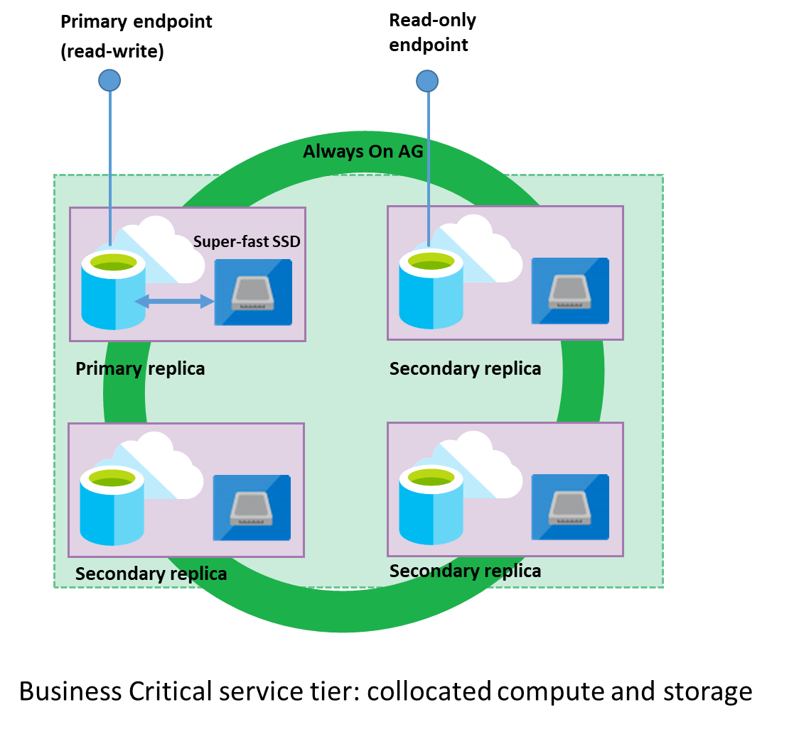
Read-only reporting
Read Scale-out
Read-only replica
Free with SQL MI BC
Notes:
https://docs.microsoft.com/en-us/azure/sql-database/sql-database-read-scale-out
As part of the High Availability architecture, each database in the Premium, Business Critical or Hyperscale service tier is automatically provisioned with a primary replica and several secondary replicas. The secondary replicas are provisioned with the same compute size as the primary replica. The Read Scale-Out feature allows you to load-balance SQL Database read-only workloads using the capacity of one of the read-only replicas instead of sharing the read-write replica. This way the read-only workload will be isolated from the main read-write workload and will not affect its performance. The feature is intended for the applications that include logically separated read-only workloads, such as analytics. They could gain performance benefits using this additional capacity at no extra cost.
3 secondary replicas, 1 is read scale out with MI BC

Slide 39
Demo: After the migration (Module 5.3)

Slide 40
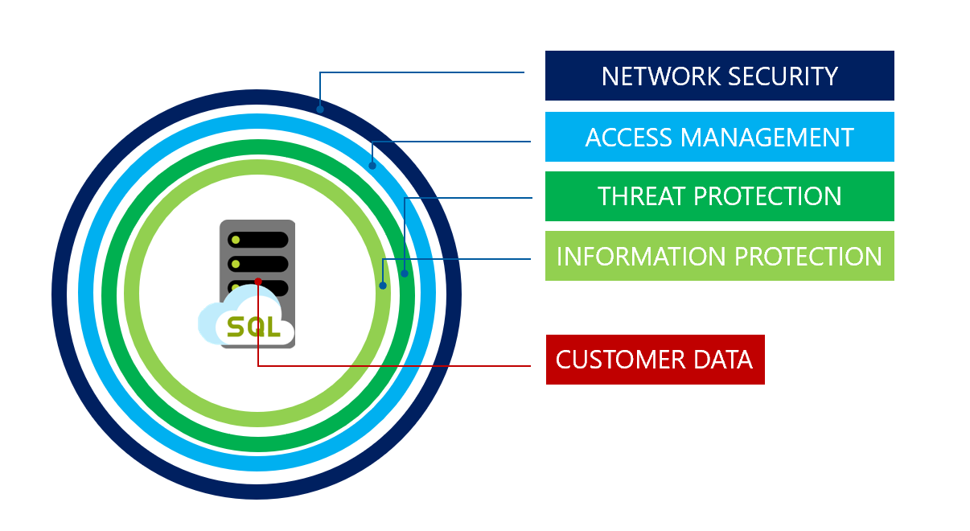
Advanced Data Security
Notes:
SQL MI includes numerous security tools that could be leveraged by Tailspin Toys, including:
SQL Database Advance Data Security
SQL Data Discovery and Classification
SQL Vulnerability Assessment service
Advanced Threat Detection
Transparent Data Encryption
Dynamic Data Masking
Row-level security

Slide 41
Learn more
http://aka.ms/annalytics
twitter: @AnalyticAnna
microsoft: antho@
Use our free training at https://aka.ms/sqlworkshops
The content from today is Modules 4 and 5 of SQL Ground to Cloud!
Learn from videos and demos at https://aka.ms/sqldbonyoutube
See and reuse useful Azure SQL slides at https://aka.ms/azuresqlslides
Engage the Azure Migrate Program at https://azure.com/AMP/

Slide 42
Module 5: Migrating to Azure SQL
Notes:
Switch PPT!

Slide 43
Data Migration Process
Notes:
*Pre-migration*:
- **Discover**: Inventory your source database assets and perform an application stack discovery.
- **Assess**: Assess source workloads and fix recommendations.
- **Convert**: Convert the source schema to work in the target environment. This is only relevant for heterogeneous migrations.
*Migration*:
- **Migrate schema, data, and objects**: Migrate the source schema and then migrate the source data to the target.
- **Sync data**: Sync your target schema and data with the source. This is only relevant for minimal-downtime migrations.
- **Cutover**: Cut over from the source to the target environment. This is only relevant for minimal-downtime migrations.
*Post-migration*:
- **Remediate applications**: Iteratively make any necessary changes to your applications.
- **Perform Tests**: Iteratively run functional and performance tests.
- **Optimize**: Based on the tests you performed, address any performance issues and then retest to confirm the performance improvements.

Slide 44


What you will learn in this workshop
Capability exists for Azure SQL Database
(Managed instance, single databases,
and elastic pools)
Capability exists for Azure SQL VMs
Discover and assess what and where to migrate to Azure
Azure Migrate
Migrate to Azure SQL Managed Instance with little to no downtime
Azure Database Migration Services
Improve database security with Advanced Data Security
SQL Data Discovery and Classification
Obtain read-scale out for read only queries
Online secondary read replica
Vulnerability Assessment
Data Migration Assistant
TODAY

Slide 45
Module 5: Migrating to Azure SQL Lab 5.1 Activities 1-9 (skip 4-5)
Notes:
Switch PPT!

Slide 46
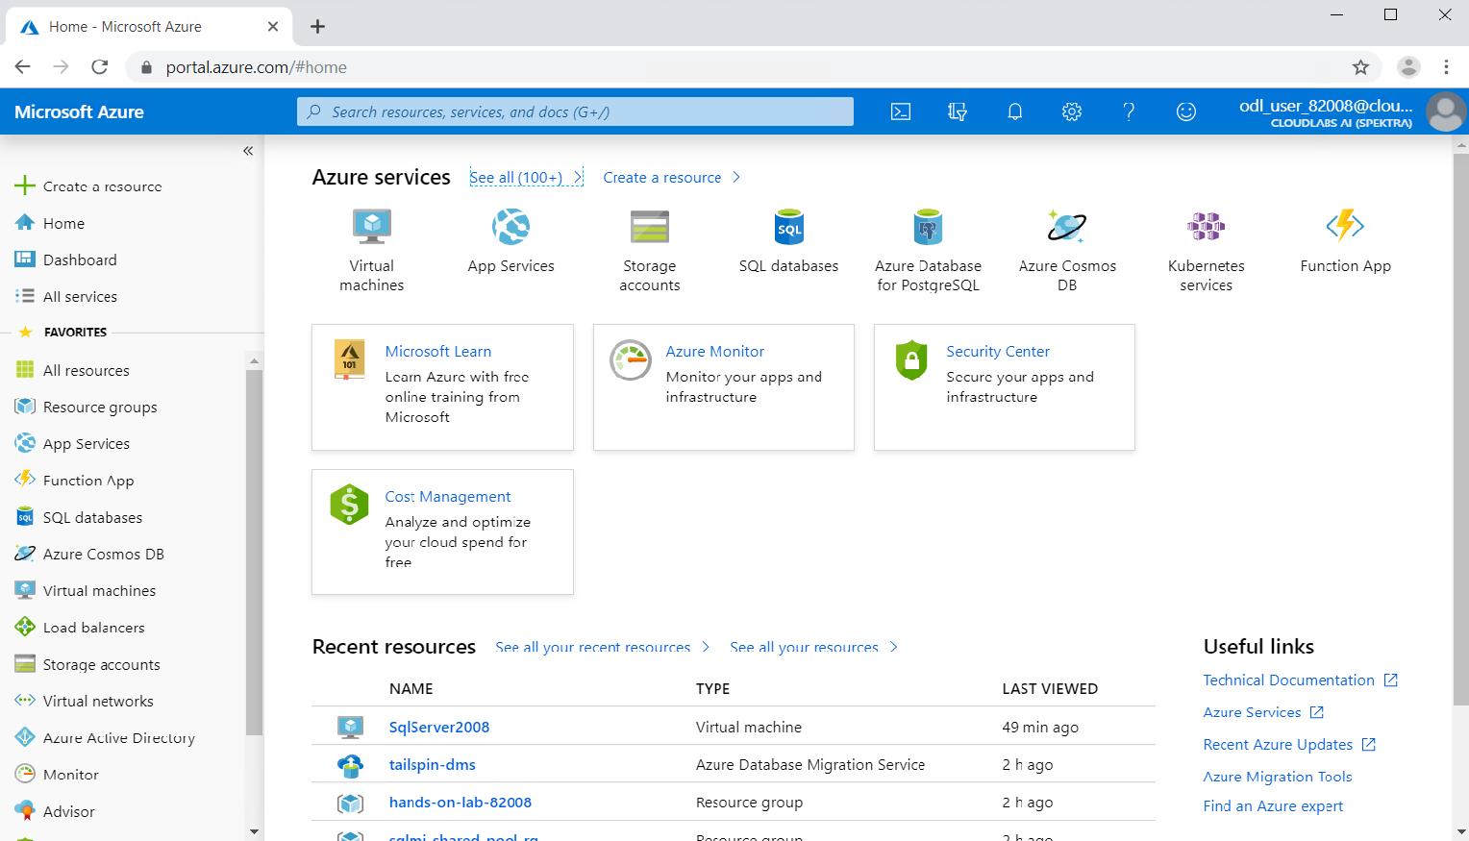

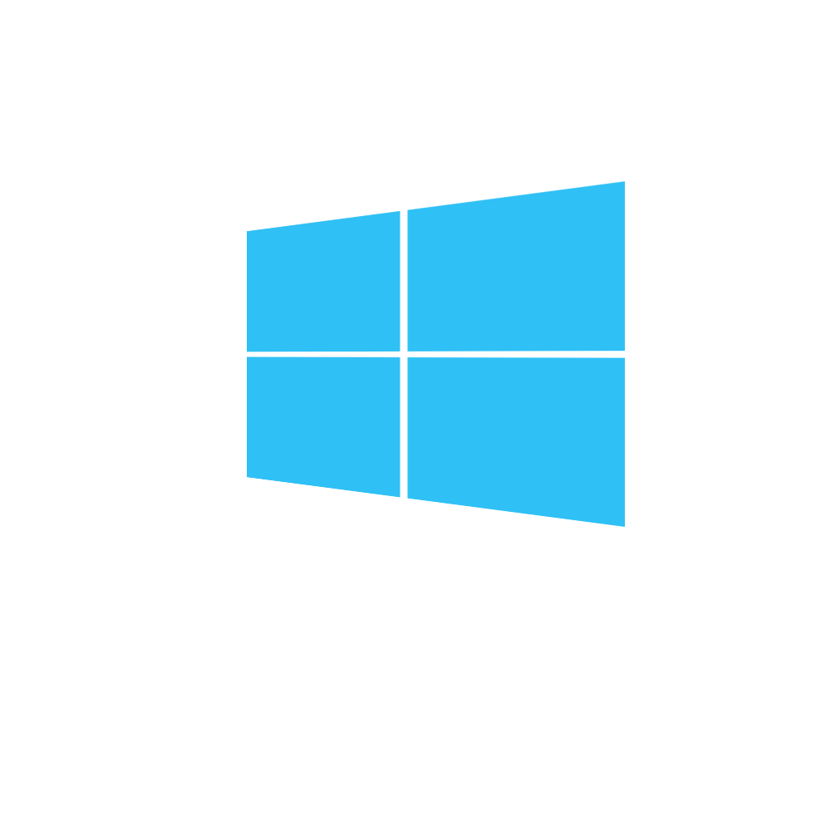
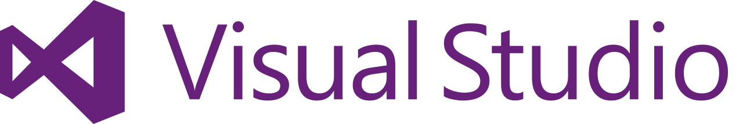
Using Module 5 Lab Resources
Database Migration Project
Application/ClientId
Application Secret Key
SQL 2008 VM
sqlVmPublicIp
sqlvmUsername
sqlvmPassword
sqlVmPrivateIp
SQL Login
SQLServer2008Username
SQLServer2008Password
Azure portal
SQL
rdp
JumpBox VM
rdp
miFQDN
sqlMiUsername
sqlMiPassword
Your laptop
jbvmDnsName
vmUsername
vmPassword

Slide 47
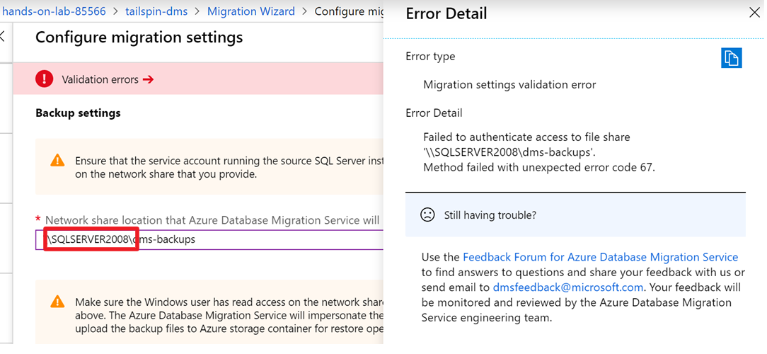
Module 5, Activity 6, Step 11
Replace SQLSERVER2008 with sqlVmPrivateIp

Slide 48
Preferred solution – Gaming services
Azure Site Recovery to migrate VMs
Multi-region deployments to address latency
VM scale sets for scalability of VMs
Availability Zones for high-availability
Availability Zones for VMs
Auto-failover groups in SQL MI (in public preview)
Geo-restore and geo-replication
Notes:
NOTE: Auto-failover groups for Managed Instance is currently in public preview. For customers who object to using a preview feature, a manual failover process would need to be implemented. This could involve setting up transactional replication to another SQL MI in a different region. VNet peering would need to be established between the virtual networks.

Slide 49
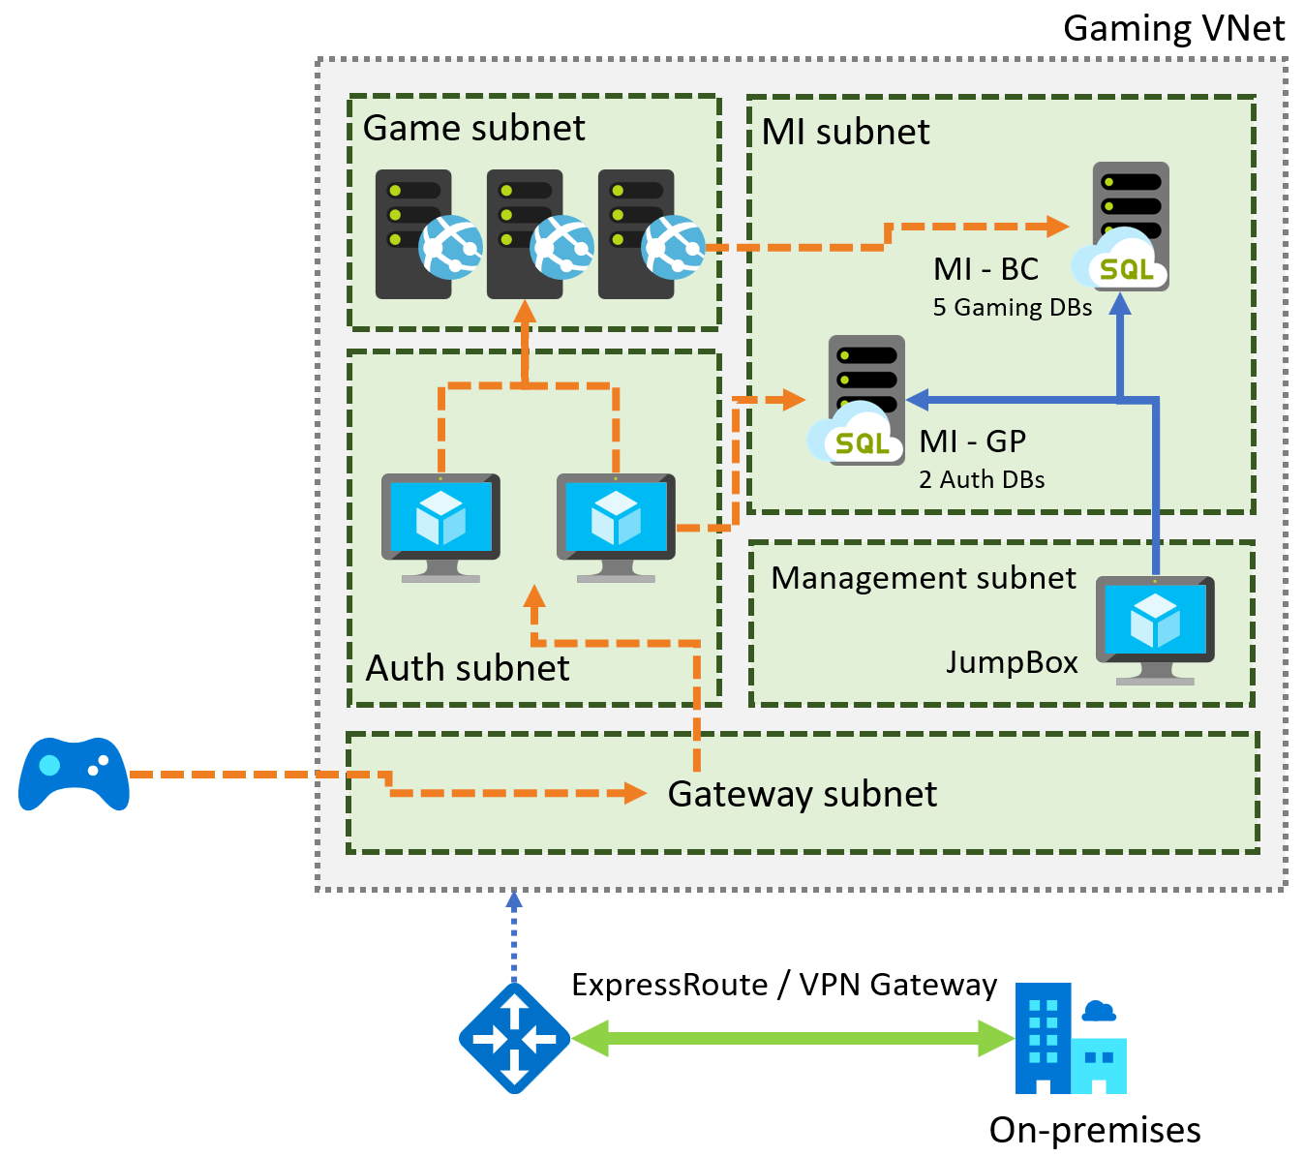
Preferred solution – Gaming services
Notes:
Diagram of the preferred solution for the gaming services. The gaming services are hosted in a VNet, with subnets for MI, Game, Management, Auth, and a Gateway subnet. SQL MI instances are hosted in the MI subnet. Gaming IaaS VMs are hosted in the Game subnet. Authorization VMs are in the Auth subnet, and a JumpBox is in the Management subnet. On-premises resources can access the VNet through ExpressRoute or a VPN gateway.

Slide 50
Cloud vendor lock-in
PaaS database services can be used
Use transactional replication to move data out

Slide 51
Preferred solution – Database security
Notes:
SQL MI includes numerous security tools that could be leveraged by Tailspin Toys, including:
SQL Database Advance Data Security
SQL Data Discovery and Classification
SQL Vulnerability Assessment service
Advanced Threat Detection
Transparent Data Encryption
Dynamic Data Masking
Row-level security

Slide 52
Networking Fundamentals

Slide 53
Networking 101: Azure Virtual Networks
Azure Virtual Network (VNet)
Logically isolated network on Azure
Allows resources to securely communicate with each other, the internet, and on-prem networks.
Scoped to a single region
Segmented into one or more subnets
Subnets: segmentation of VNets to organize and secure resources in discrete sections
VNet Peering: used to connected multiple virtual networks (can be different regions)
VPN Gateway: provides secure connection between Azure VNet and on-prem over the internet
ExpressRoute: provides secure and private connection between Azure and on-prem
Network security group (NSG): Allows or denies inbound traffic to your Azure resources (like a cloud-level firewall for your network)

Slide 54


SQL DB (single/elastic pools) connectivity architecture
CR2
TR 3
GW
Node
Node
mysqldbsrv.database.windows.net
Node
Node
`
CR1
westus1-a.control.database.windows.net
104.44.238.205
1433
GW
GW
proxy
TR22
Node
Node
(1) redirect-find-db
GW
Node
Node
(2) redirect-query
tr22.westus1-a.worker.database.windows.net
13.94.237.158
11000 -11999
Notes:
https://docs.microsoft.com/en-us/azure/sql-database/sql-database-connectivity-architecture
Front end Gateway (1+) and back-end Sql Server hosts database
Talk about why proxy is default from outside azure ? Redirect from inside azure?
Nslookup demo of cr
Wireshark for TR

Slide 55
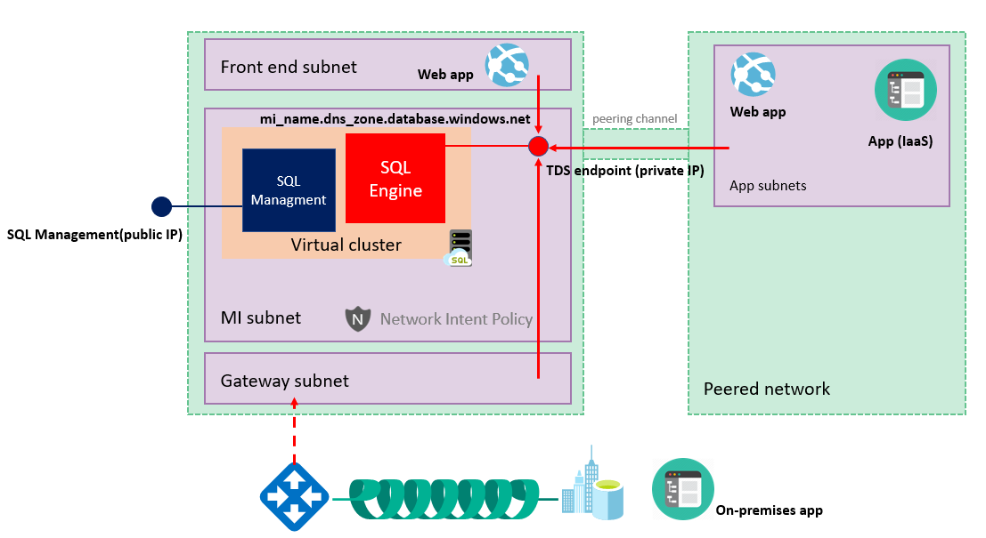
SQL MI connectivity architecture
Notes:
https://docs.microsoft.com/en-us/azure/sql-database/sql-database-managed-instance-connectivity-architecture
SQL MI is deployed into an isolated subnet in a VNet
At a high level, a managed instance is a set of service components. These components are hosted on a dedicated set of isolated virtual machines that run inside the customer's virtual network subnet. These machines form a virtual cluster.
A virtual cluster can host multiple managed instances. If needed, the cluster automatically expands or contracts when the customer changes the number of provisioned instances in the subnet.
Customer applications can connect to managed instances and can query and update databases inside the virtual network, peered virtual network, or network connected by VPN or Azure ExpressRoute. This network must use an endpoint and a private IP address.
Management and deployment services (which run outside the virtual network) connect and manage the managed instance with a management endpoint that maps to an external load balancer. This endpoint is inside the instance's virtual cluster. The management endpoint is protected by a built-in firewall on the network level. Microsoft services and a managed instance (via the management endpoint) connect over the endpoints that have public IP addresses, so when a managed instance creates an outbound connection, it looks like it's coming from this public IP address. Find more information about determining the management endpoint's IP address, traffic, and the built-in firewall here.
Managed instances must be deployed in a dedicated subnet inside the virtual network. There are certain network requirements for the subnet that is to contain a managed instance. You should review and prepare accordingly.

Slide 56
Dedicated resources through customer isolation
VNet-to-VNet
Web app (public IP)
VNet1
SQL instance #1
SQL instance #2
Network isolation (customer VNET)
Tenant isolation (compute, storage)
SQL instance #3
“Virtual data cluster” dedicated to customer (virtual private cluster, VNET, private IPs)
VPN/Express route gateway
On-premises
Notes:
SQL Database Managed Instance provides complete workload isolation of your workloads through native VNET support. We use virtual data clusters to describe the degree of isolation that customer workloads will experience with SQL Database Managed Instance. During service provisioning (on Azure Portal or through REST API), you can choose the virtual network (VNET) and the subnet to achieve full networking isolation for your Managed Instances. Once created, instances in the VNET can be reached using Azure networking mechanisms (VPN and Express Route gateways).

Slide 57



Isolation and connectivity of Managed Instance
Web app (public IP)
IaaS hosted app
App subnet
VNet 2
VPN/Express route gateway
VNet-to-VNet
public IP*
Network isolation (customer VNET)
SQL instance #1
SQL instance #2
Tenant isolation (virtual private cluster)
SQL instance #3
MI Subnet
VNet 1
On-premises
Notes:
Key points:
Enable full isolation from other tenants without resource sharing
Promote secure communication over private IP addresses with native VNET integration
Enable your on-premise identities on cloud instances, through integration with Azure Active Directory and AD Connect
To two levels of isolation are provided:
Cluster (tenant ring) level: Managed Instances for a tenant are fully isolated from other tenants. No connectivity or resource sharing is possible between different tenants.
Networking level: joining instances to a subnet in a VNET and restricting access to private IP addresses only provides full isolation from public Internet.
SQL Database Managed Instance provides complete workload isolation of your workloads through native VNET support.
We use virtual data clusters to describe the degree of isolation that customer workloads will experience with SQL Database Managed Instance. During service provisioning (on Azure Portal or through REST API), you can choose the virtual network (VNET) and the subnet to achieve full networking isolation for your Managed Instances. Once created, instances in the VNET can be reached using Azure networking mechanisms (VPN and Express Route gateways).

Slide 58
MI Virtual Cluster
SQL Management (public IP)
TDS endpoint (private IP)
Virtual cluster
SQL
VNet
Node
GW
mymi.<clusterid>.database.windows.net
primary node
TLS
ILB
Node
GW
Windows Firewall
TDS endpoint
(Private IP)
Node
SQL
Engine
TLS
SQL Management
Node Agent
TLS
LB
GW
SQL Management (Public IP)
Notes:
We assume breach…
Enhanced monitoring of our Azure Assets
Collection of low-fidelity anomalous activity (automated hunting)
Monitoring PERF for traits of crypto currency mining
… and large set of other detections that we don’t talk about publicly
Attack team, SQL Red Team, tries to get in, gain a foothold, escalate privileges, and maintain persistence
SQL Blue Team practices defense-in-depth
When we detect something, e.g., failed login attempts, we defend…
If it involves customer, we will notify
Many times this is the customer’s own security and compliance scanners!

Slide 59

Host your application in the cloud or keep on-premises
SQL MI VNet
“VNet Integration”
Web app
App subnet
App Service
“VNet Integration”
Web app peered VNet
IaaS Hosted
App
App
Application VNet
MI subnet
Peering / VPN Channel
App subnet
IaaS Hosted
App
App Service
SQL Managed Instance #1
SQL Managed Instance #2
App
Express Route / VPN Gateway
On-premise app
App
Notes:
Key point(s)
You may choose to host application in the cloud either by using Azure App Service or some of Azure's virtual network (VNet) integrated options like Azure App Service Environment, Virtual Machine, Virtual Machine Scale Set. You could also take hybrid cloud approach and keep your applications on-premises.
https://docs.microsoft.com/en-us/azure/sql-database/sql-database-managed-instance-connect-app
Azure resources can communicate privately with each other through an Azure Virtual Network (VNet). A VNet is a logical isolation of the Azure cloud dedicated to your subscription.
You can implement multiple VNets within each Azure subscription and Azure region. Each VNet is isolated from other VNets.
You can connect Vnets to each other, enabling resources connected to either Vnet to communicate with each other across VNets
https://docs.microsoft.com/en-us/azure/virtual-network/virtual-networks-overview?toc=%2fazure%2fnetworking%2ftoc.json
Peering
Enables resources connected to different Azure Vnets within the same region to communicate with each other
https://docs.microsoft.com/en-us/azure/virtual-network/virtual-network-peering-overview?toc=%2fazure%2fnetworking%2ftoc.json
VPN Gateway
Enables resources connected to different Azure Vnets within different Azure region to communicate with each other
https://docs.microsoft.com/en-us/azure/vpn-gateway/vpn-gateway-howto-vnet-vnet-resource-manager-portal?toc=%2fazure%2fnetworking%2ftoc.json

Slide 60
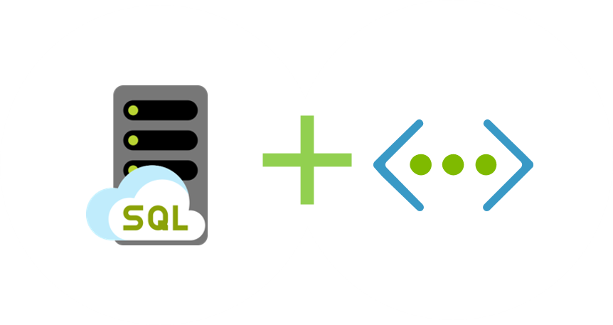
Network isolation
Notes:
SQL MI is deployed into an isolated Vnet
Subnets are used to allow access to SQL MI
On-premises access can be granted through ExpressRoute or a VPN Gateway

Slide 61

VNet
Virtual cluster
Node
GW
primary node
mi_name.<dns_zone>.database.windows.net
TLS
ILB
Node
GW
Windows Firewall
TDS endpoint (private IP)
Node
SQL
Engine
TLS
SQL Management
Node Agent
TLS
LB
GW
SQL Management (public IP)

Slide 62
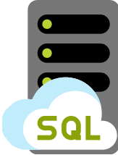

Legend:
Data
VNet
Azure SQL Database
Managed Instance
Customer applications & tools
On-Premises + Azure VNet

Slide 63


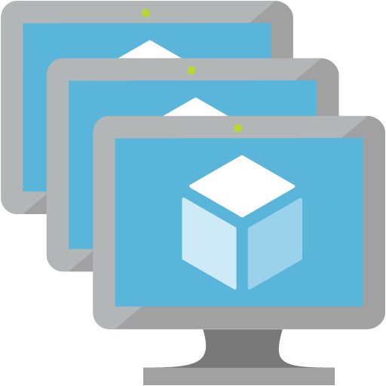
Legend:
Data
Management
Certificate
Azure
VNet
Management & Deployment
Azure
Azure SQL Database
Managed Instance
Customer applications & tools
On-Premises + Azure VNet
Maintenance
Corpnet

Slide 64


Legend:
Data
Management
Certificate
Azure
VNet
Certificate Revocation List
Management & Deployment
Azure
Azure SQL Database
Managed Instance
Service dependencies Azure
Customer applications & tools
On-Premises + Azure VNet
Maintenance
Corpnet

Slide 65
Legend:
Data
Management
Certificate
Azure
VNet
TLS
TLS
Certificate Revocation List
TLS
Management & Deployment
Azure
Azure SQL Database
Managed Instance
TLS
TLS
Service dependencies Azure
Customer applications & tools
On-Premises + Azure VNet
Maintenance
Corpnet

Slide 66



Secure access using Public Endpoint
Azure
VNet
VNet
Allow In | 56.226.155.47 | 3342
VIP
56.226.155.47
3342
Public IP
52.246.255.77
Allow Out | 52.246.255.77 | 3342
Allow In | 23.125.76.123 | 3342
 | 20.45.12.456
Allow Out | 52.246.255.77 | 3342
SNAT IP
23.125.76.123
20.45.12.456
Customer applications & tools
On-Premises

Slide 67
App integration and network security
App subnet
“VNet Integrated”
web app
“VNet Integrated”
web app (peered VNet)
App Service
Environment
3
4
1
2
IaaS hosted app
Application VNet
Peering / VPN channel
MI subnet
App subnet
5
IaaS hosted app
App Service
Environment
6
Managed Instance #1
Managed Instance #2
7
On-premises app
Express Route / VPN Gateway

